Slide 1
An Introduction to WEKA Machine Learning
Department of Computer Science
Spring 2019
Farid Ghareh Mohammadi
Enas Alkhoshi

Slide 2
Outline
What is Weka? ( history, Loading Data)
Pre-Processing in Weka ( Filtering, Sampling, Removing, Editing, exporting)
Classification in Weka ( SVM, NN, J48, NB)
Clustering in Weka ( Kmeans)
Other tabs in Weka ( Associate, Select Attribute, Visualization)
Summary
Package Manager

Slide 3
What is WEKA
Waikato Environment for Knowledge Analysis
It’s a data mining/machine learning tool developed by Department of Computer Science, University of Waikato, New Zealand.
Weka is a collection of machine learning algorithms for data mining tasks.
Weka is open source software issued under the GNU General Public License.

Slide 4
Main Features
100+ algorithms for classification
75 data preprocessing tools
20 clustering algorithms, finding association rules
25 search algorithms for feature selection

Slide 5
Download and Install WEKA
Website: http://www.cs.waikato.ac.nz/~ml/weka/index.html
Support multiple platforms (written in java):
Windows, Mac OS X and Linux
Weka Manual:
http://transact.dl.sourceforge.net/sourceforge/weka/WekaManual-3.6.0.pdf

Slide 6
Preprocess: Choose and modify the data being acted on.
Classify: Train and test learning schemes that classify or perform regression.
Cluster: Learn clusters for the data.
Associate: Learn association rules for the data.
Select attributes: Select the most relevant attributes in the data.
Visualize: View an interactive 2D plot of the data.

Slide 7
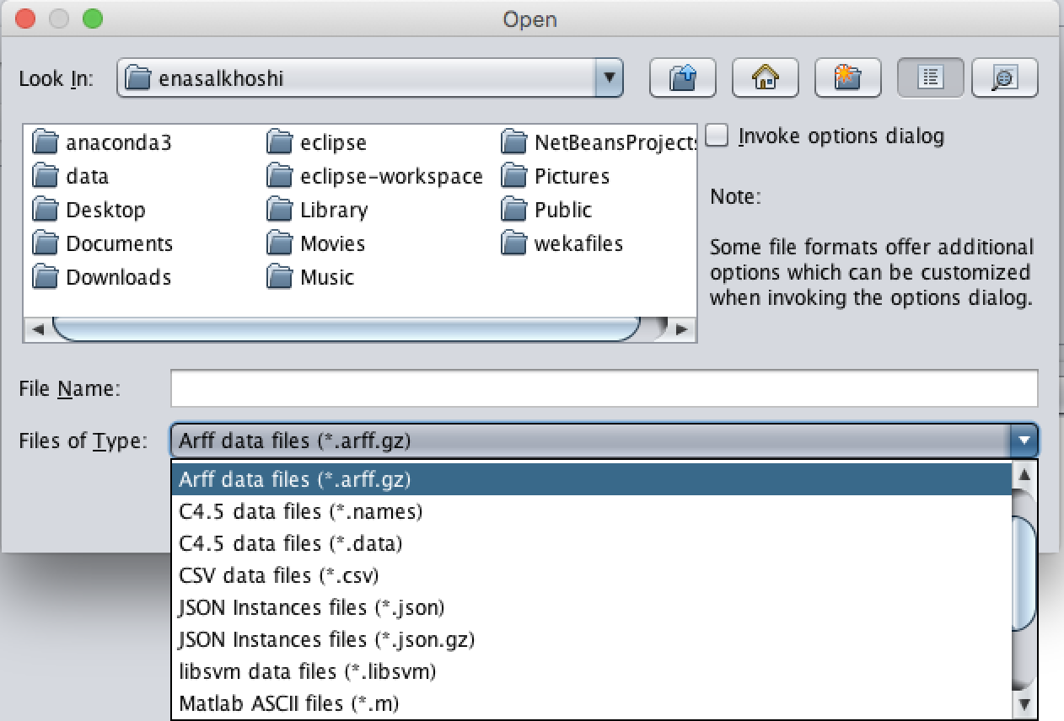
Selecting Dataset

Slide 8
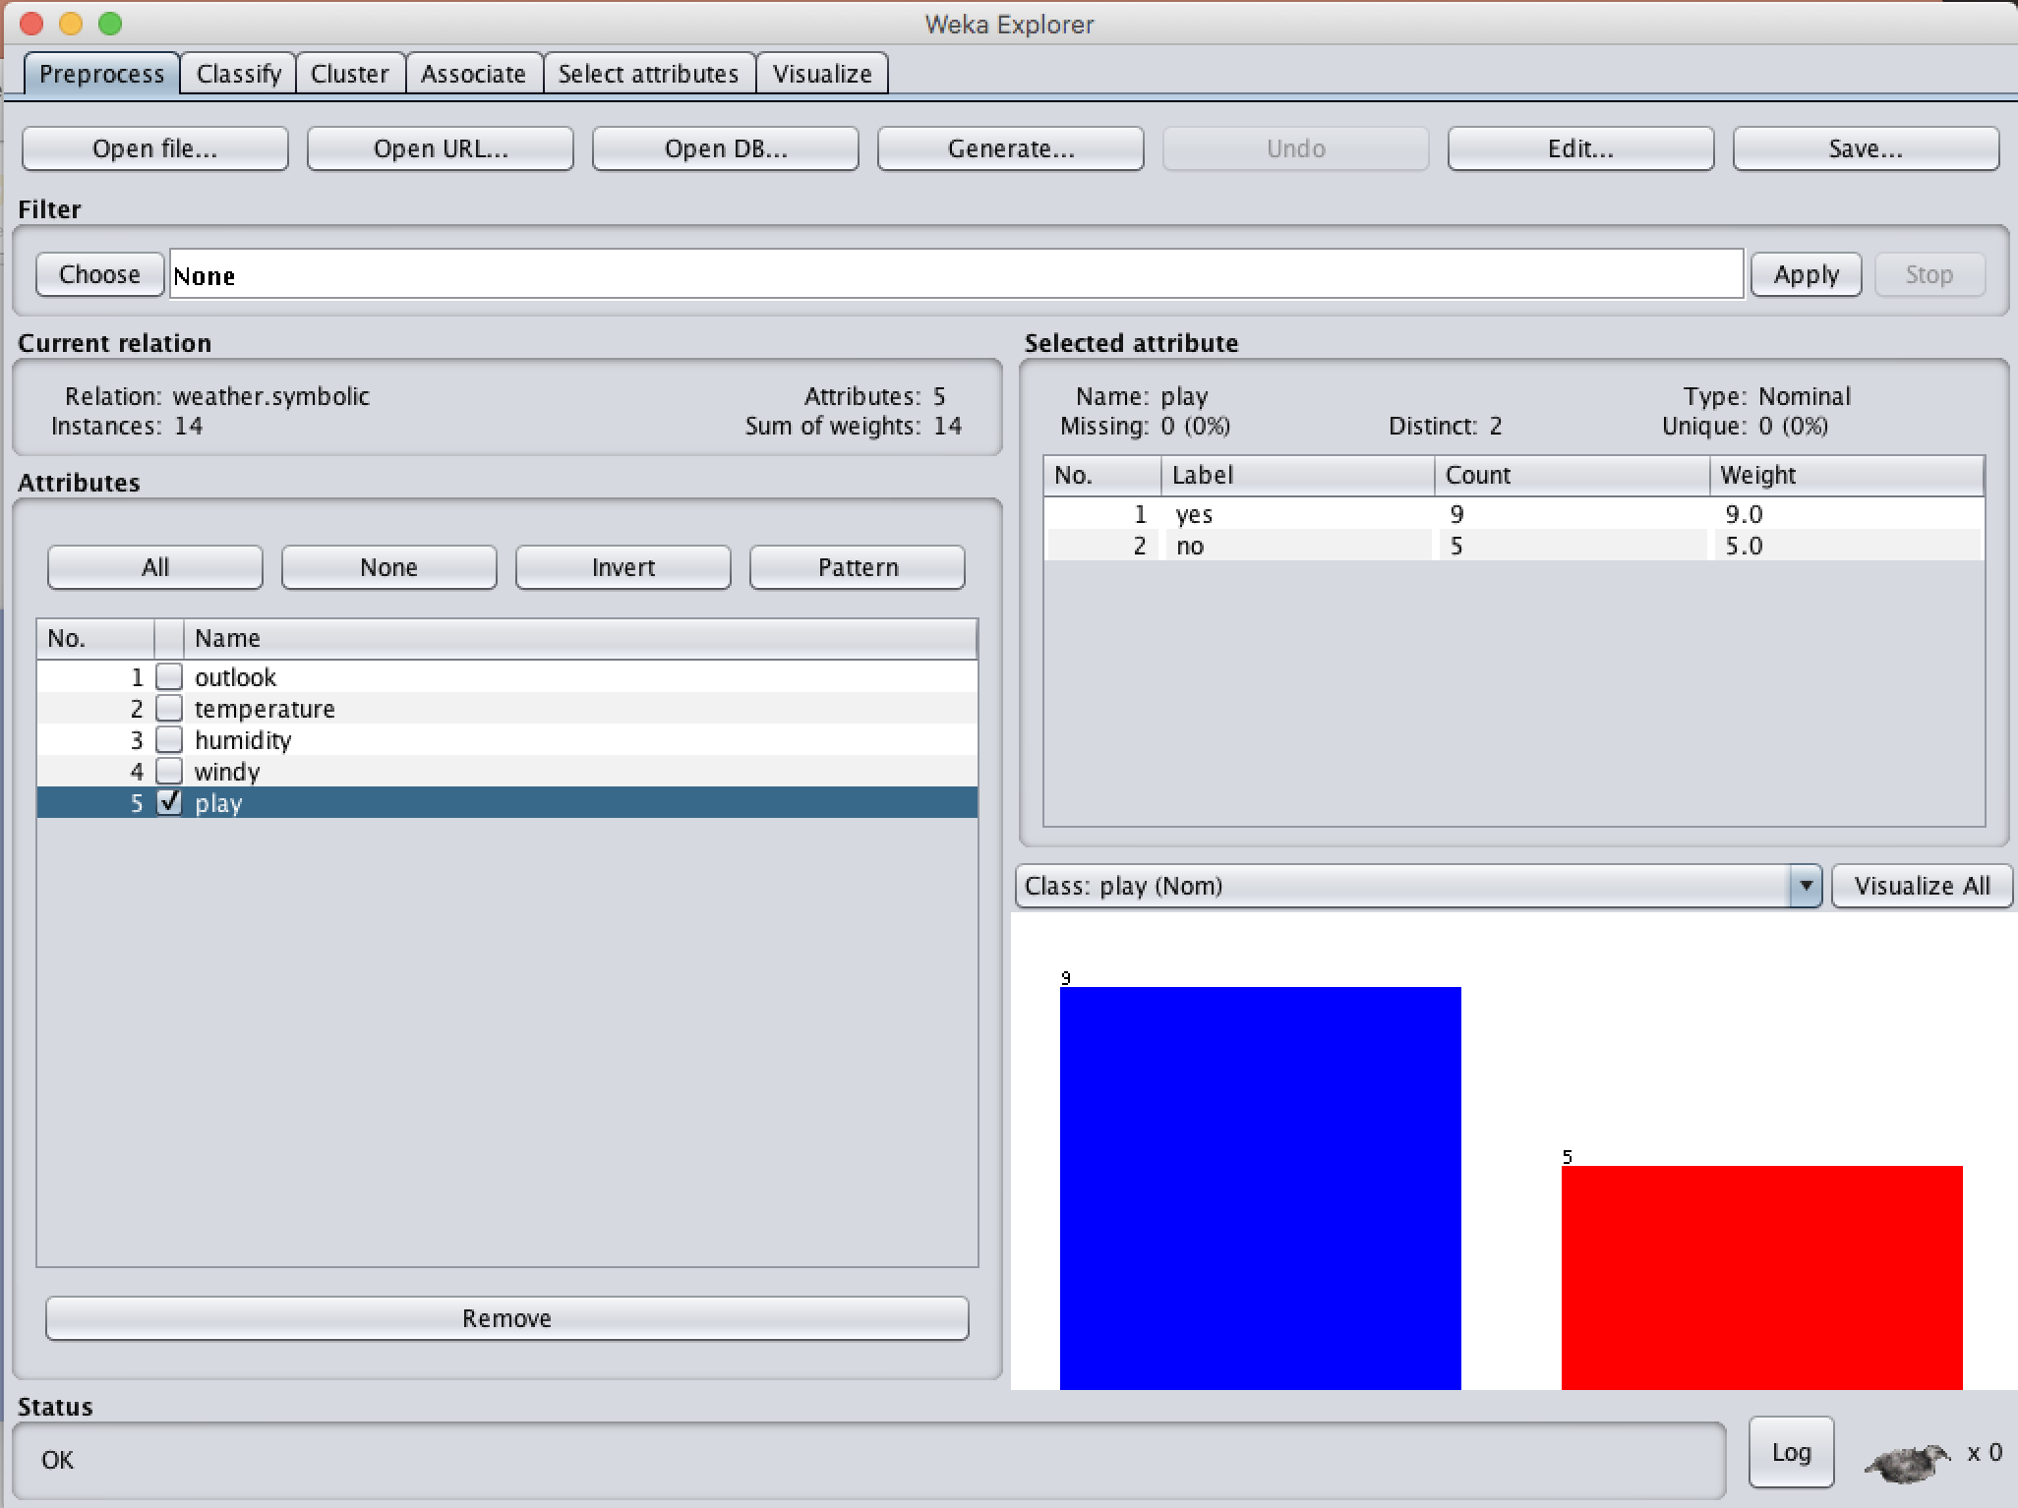
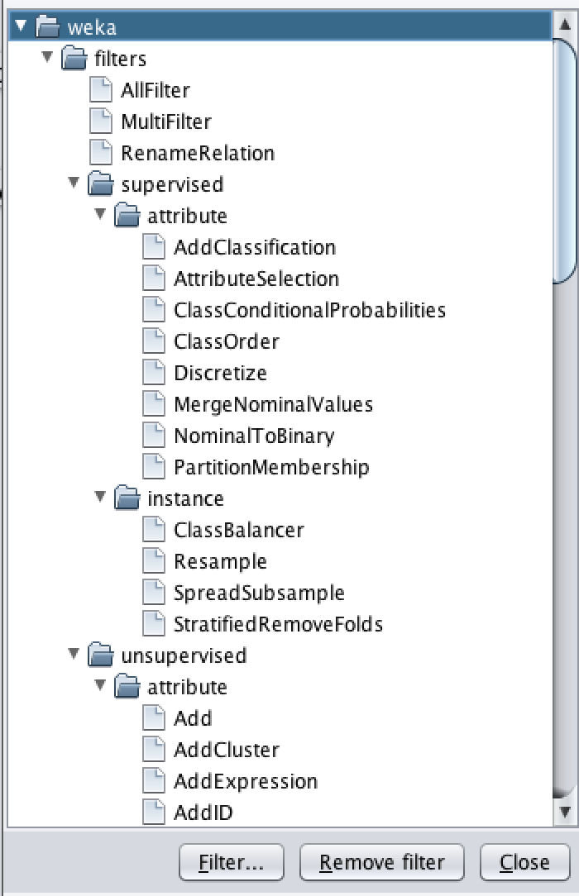
Preprocessing

Slide 9
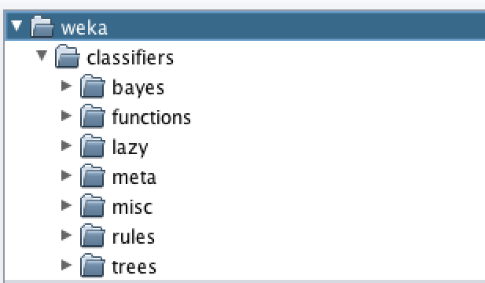
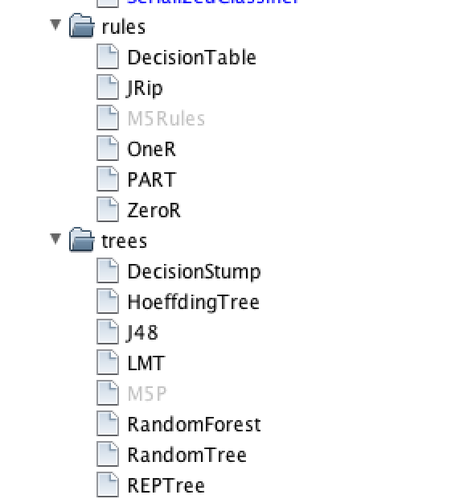
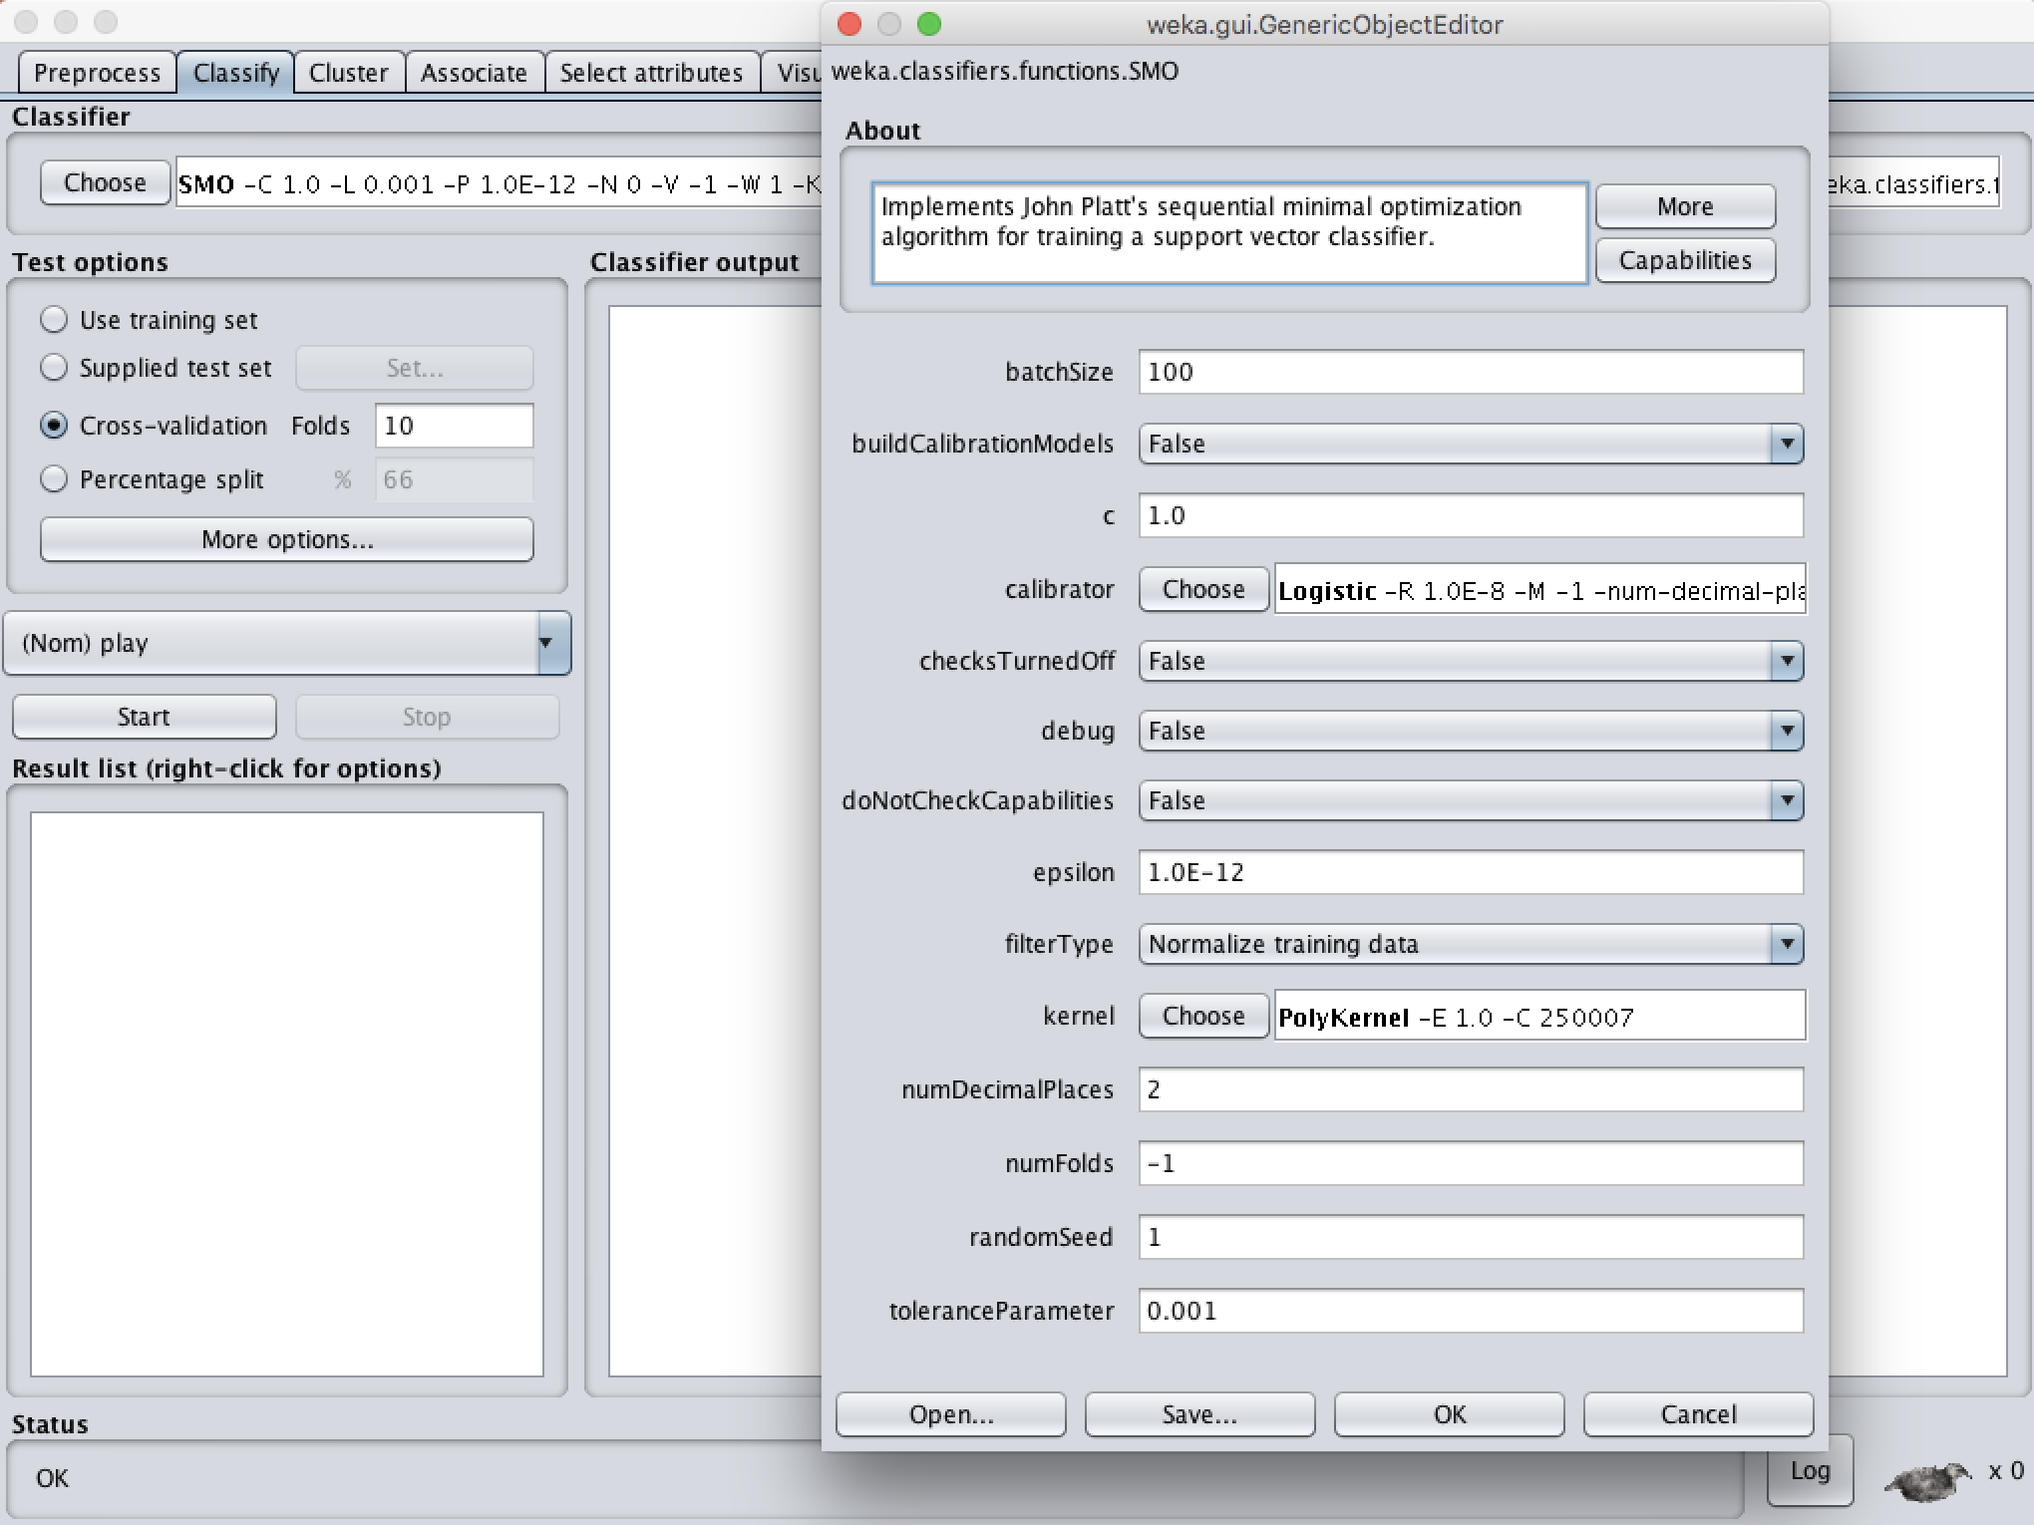
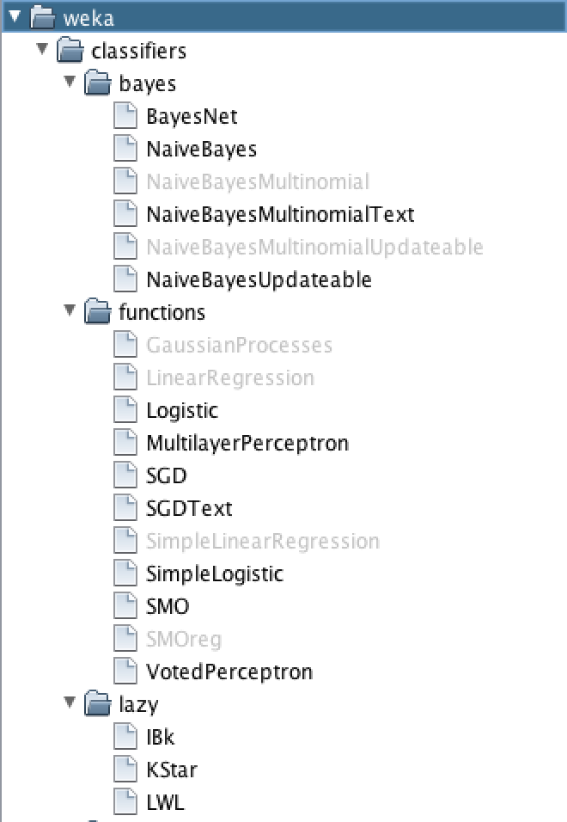
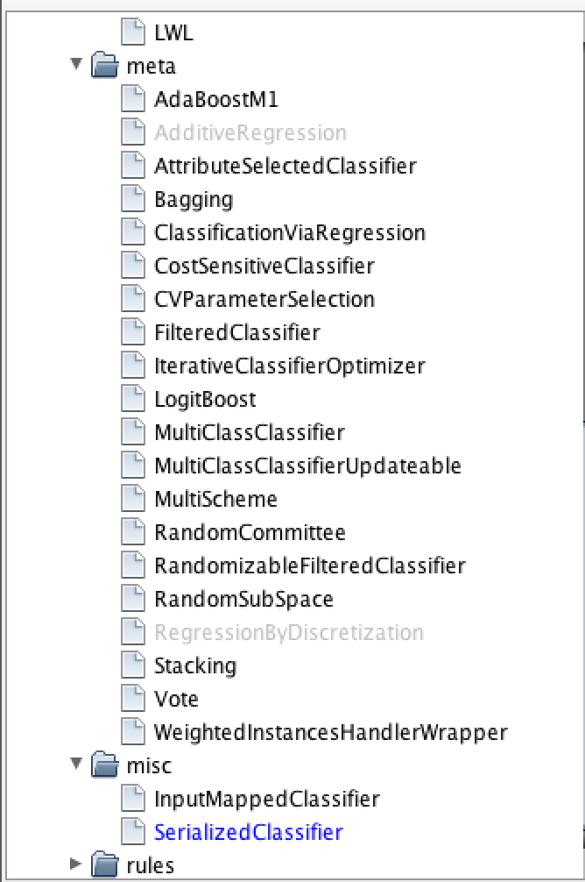
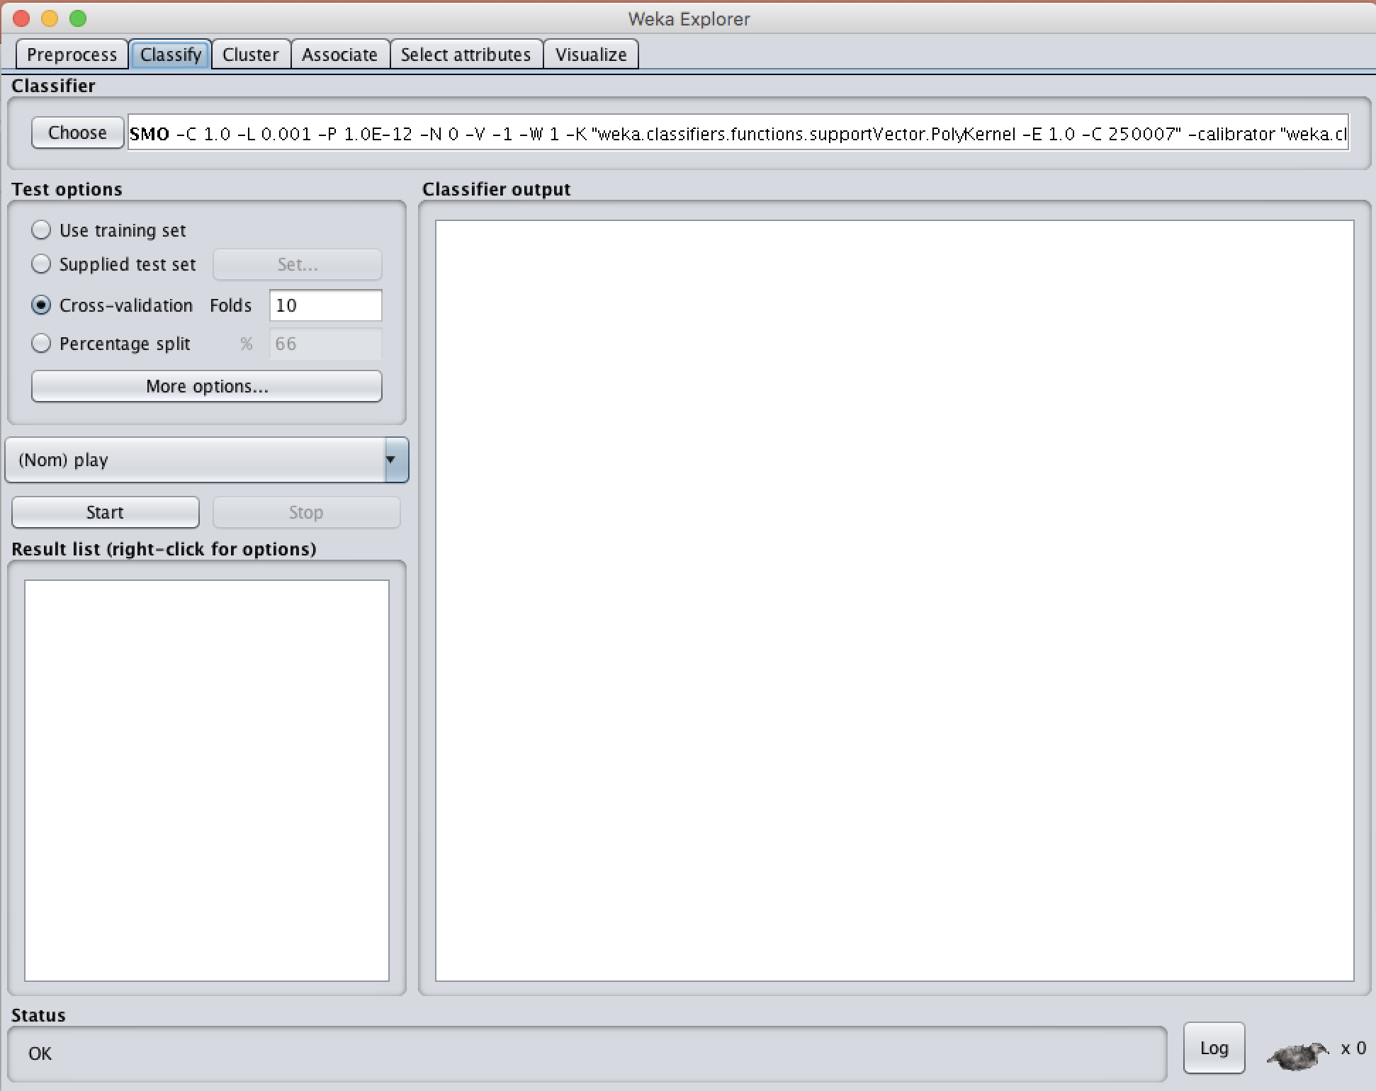
Classifiers
General properties
Specific properties

Slide 10
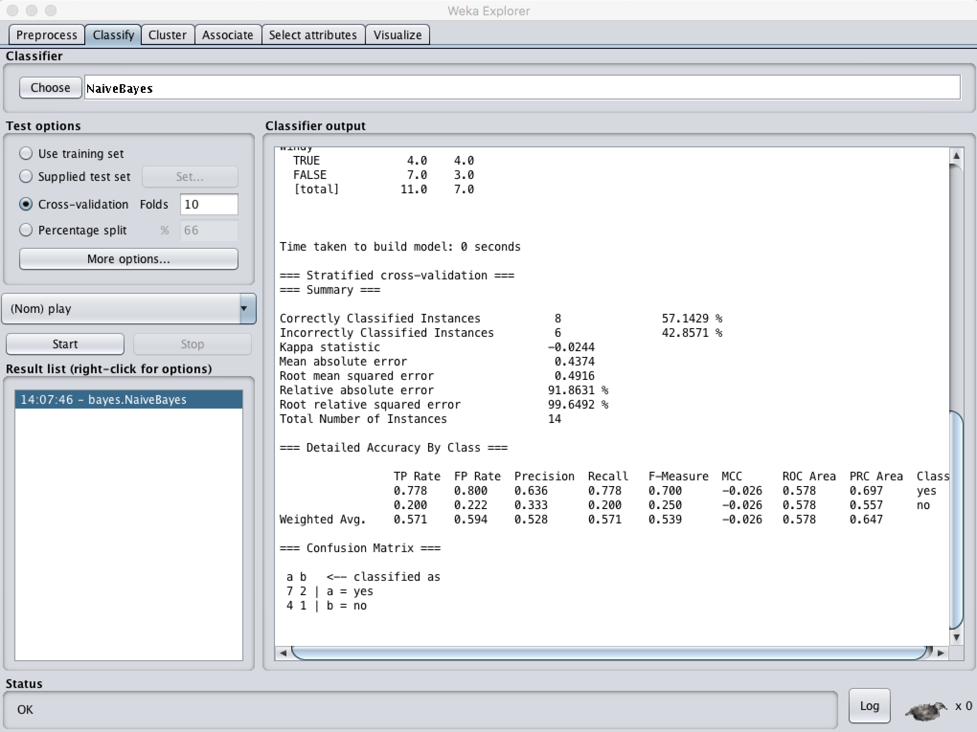
The Classification Algorithm’s Result

Slide 11
Where we are :
Clear
So far ?
Weka
Preprocessing
Classification
Clustering in Weka ( Kmeans)
Other tabs in Weka ( Associate, Select Attribute, Visualization)
Package Manager
Work with Weka

Slide 12
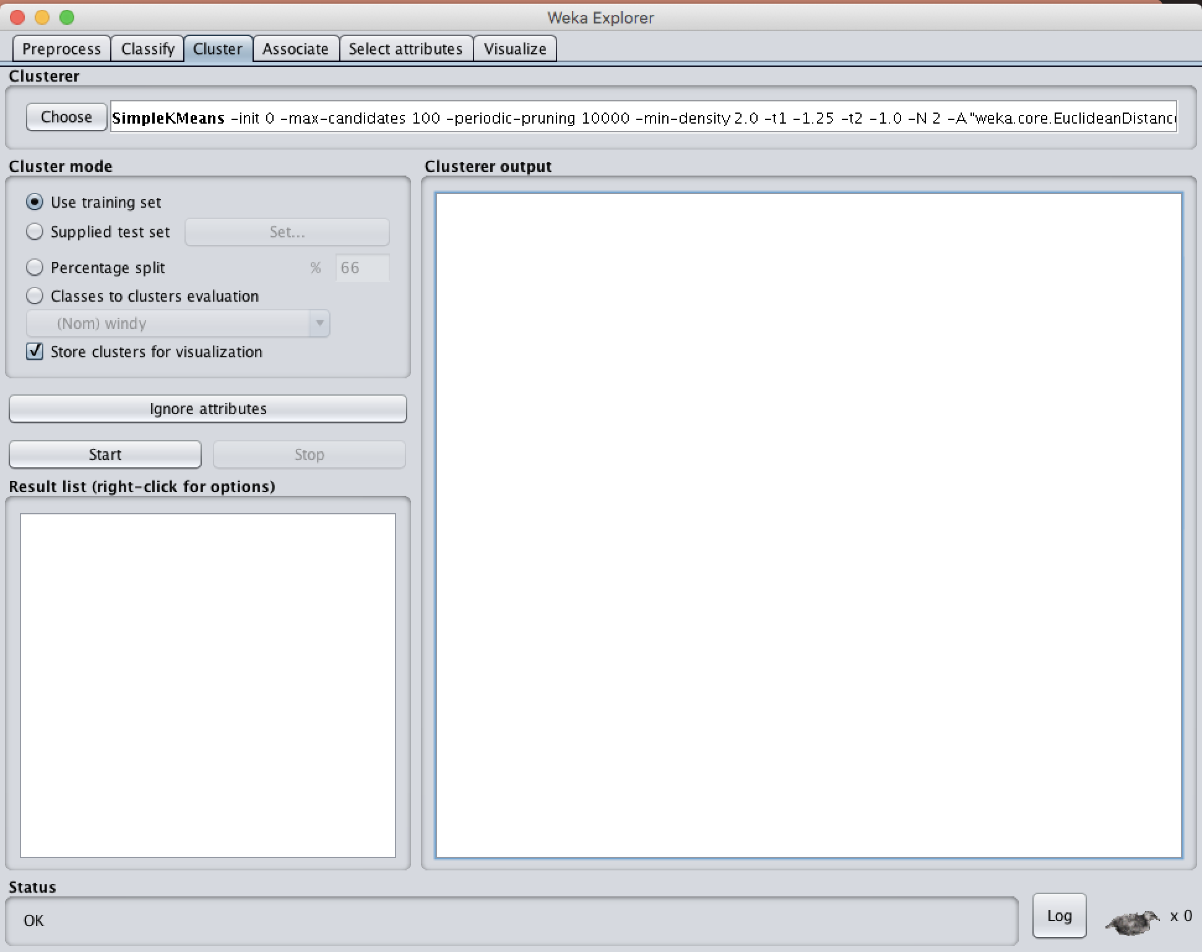
Clustering

Slide 13
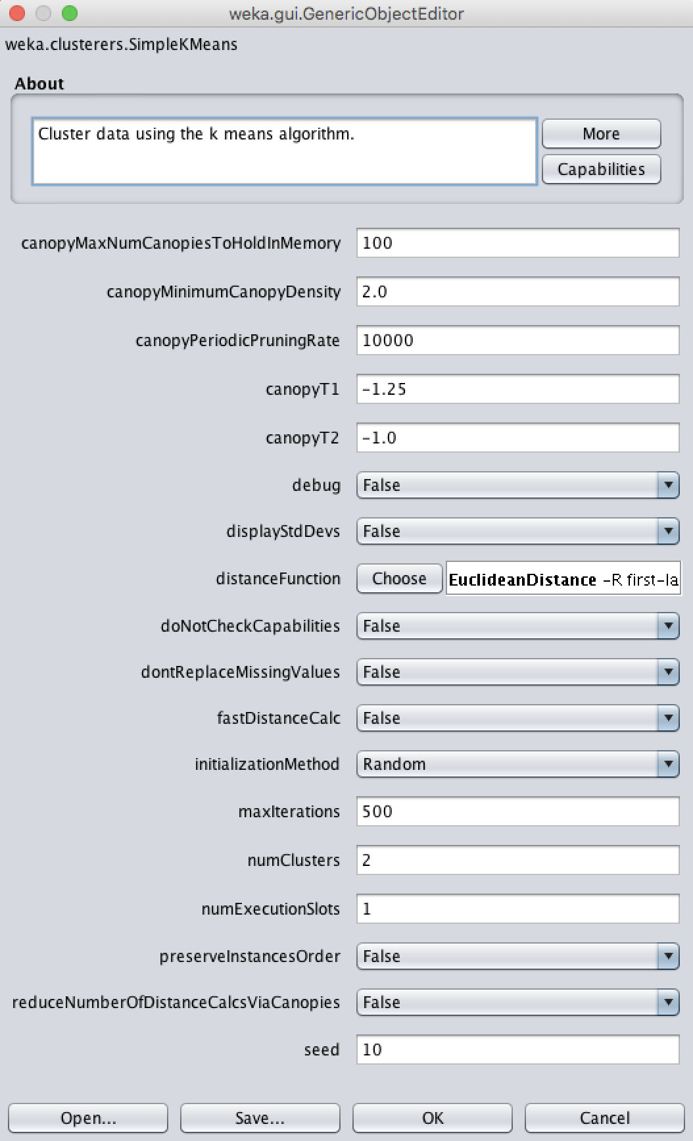
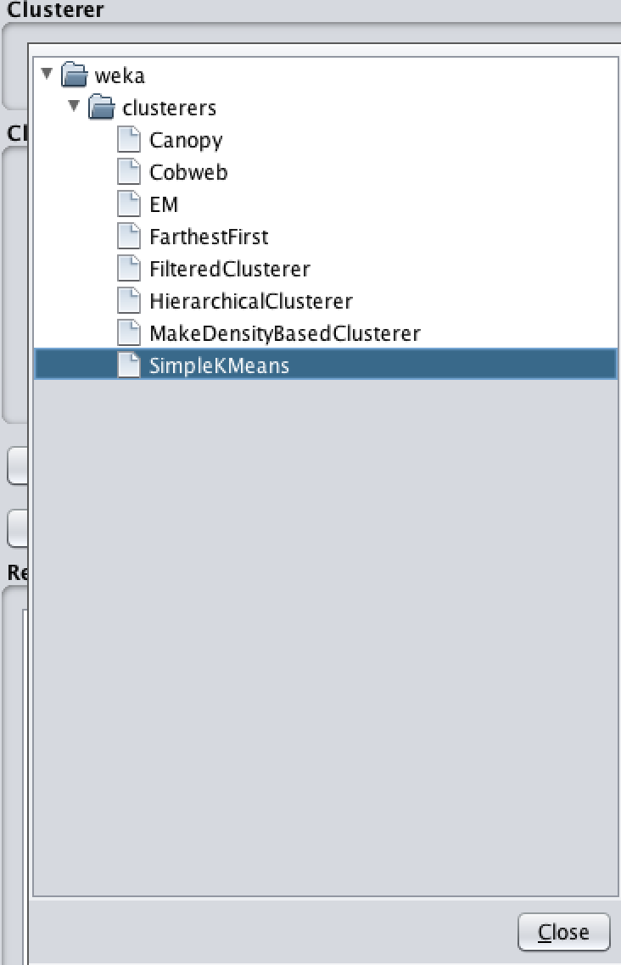
Clustering

Slide 14
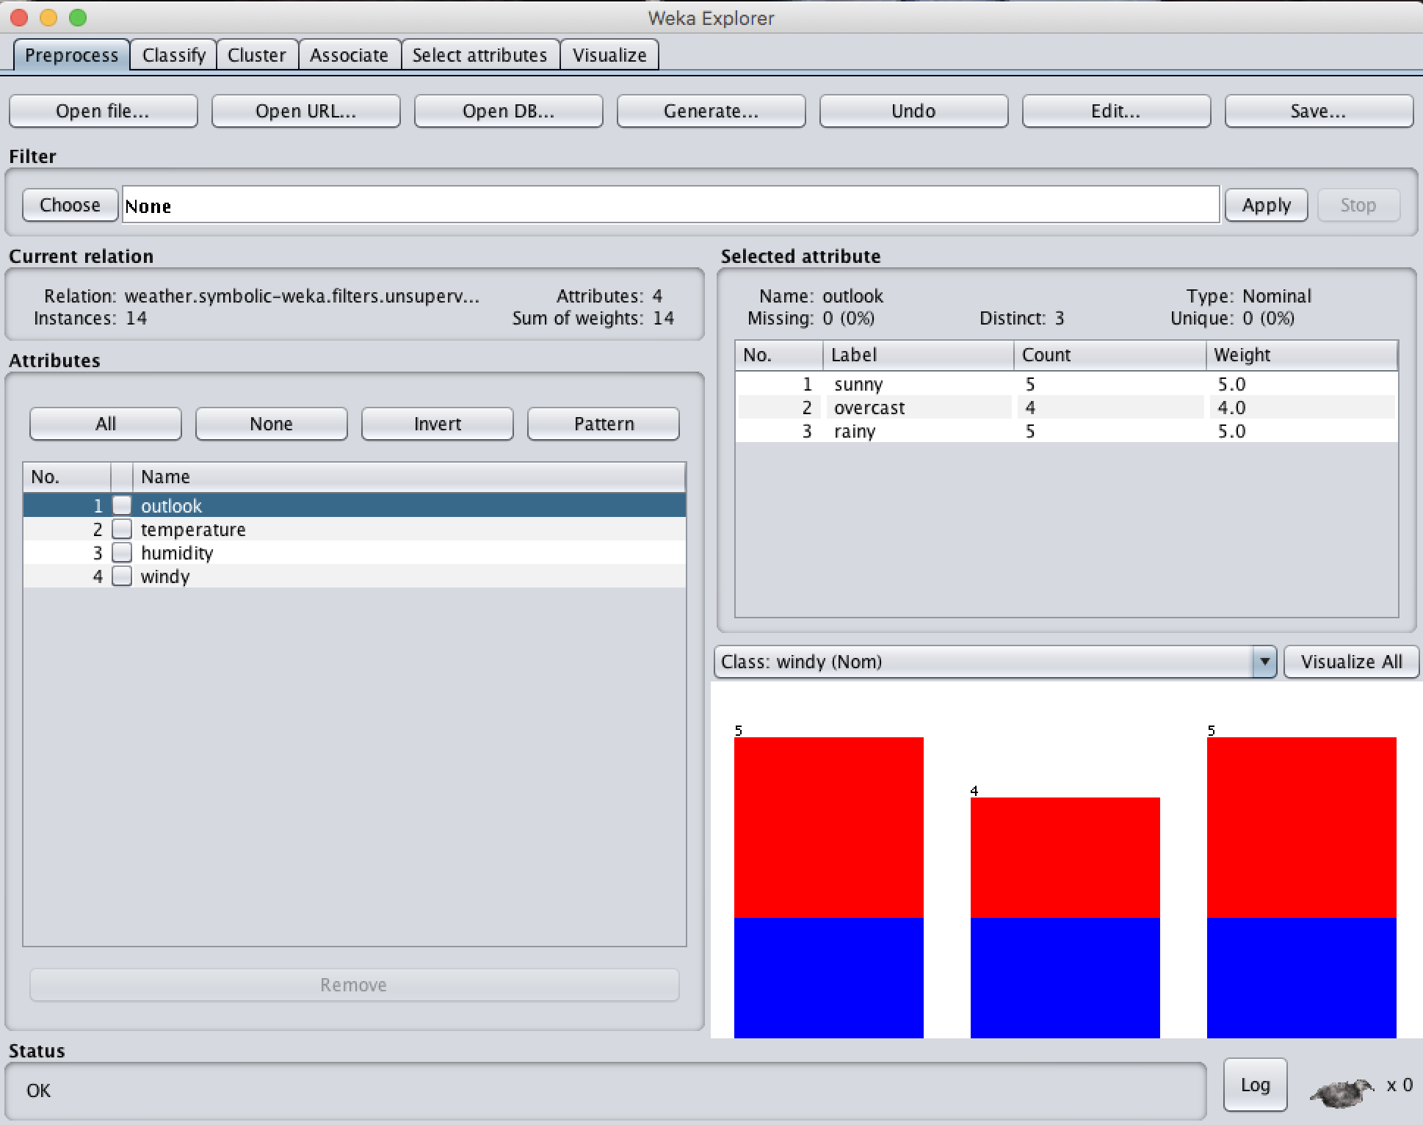
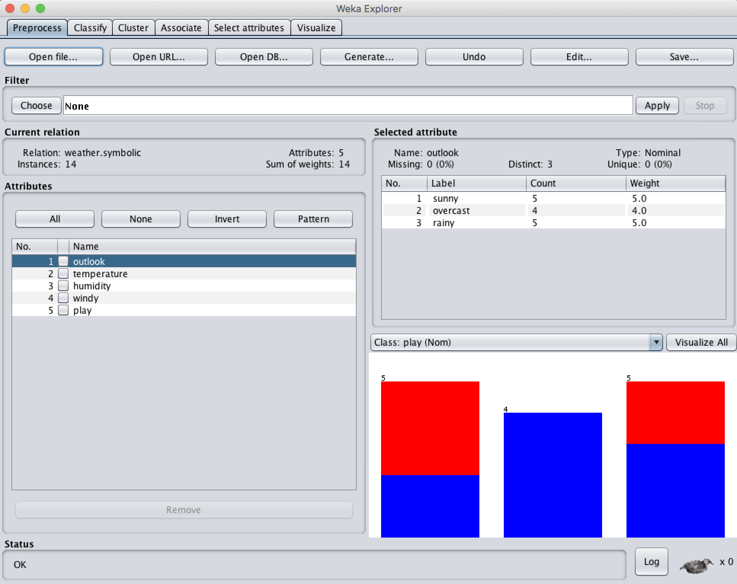
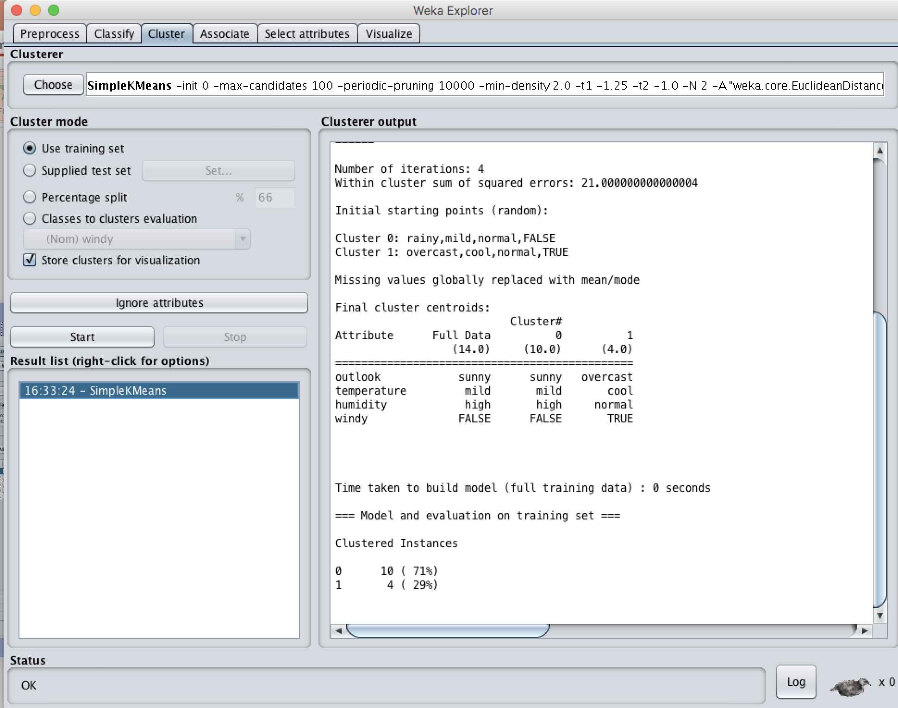
Pre- Clustering (In case) – Practical

Slide 15
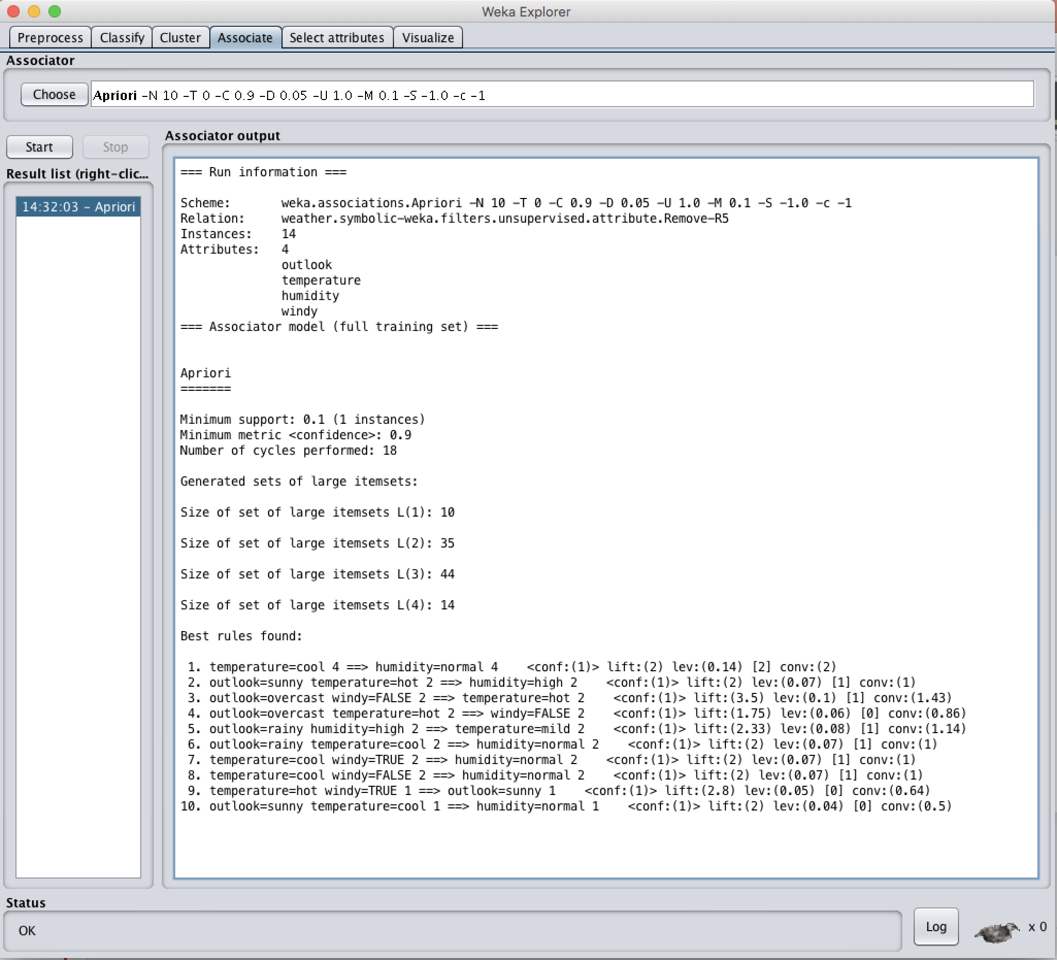
Associate

Slide 16
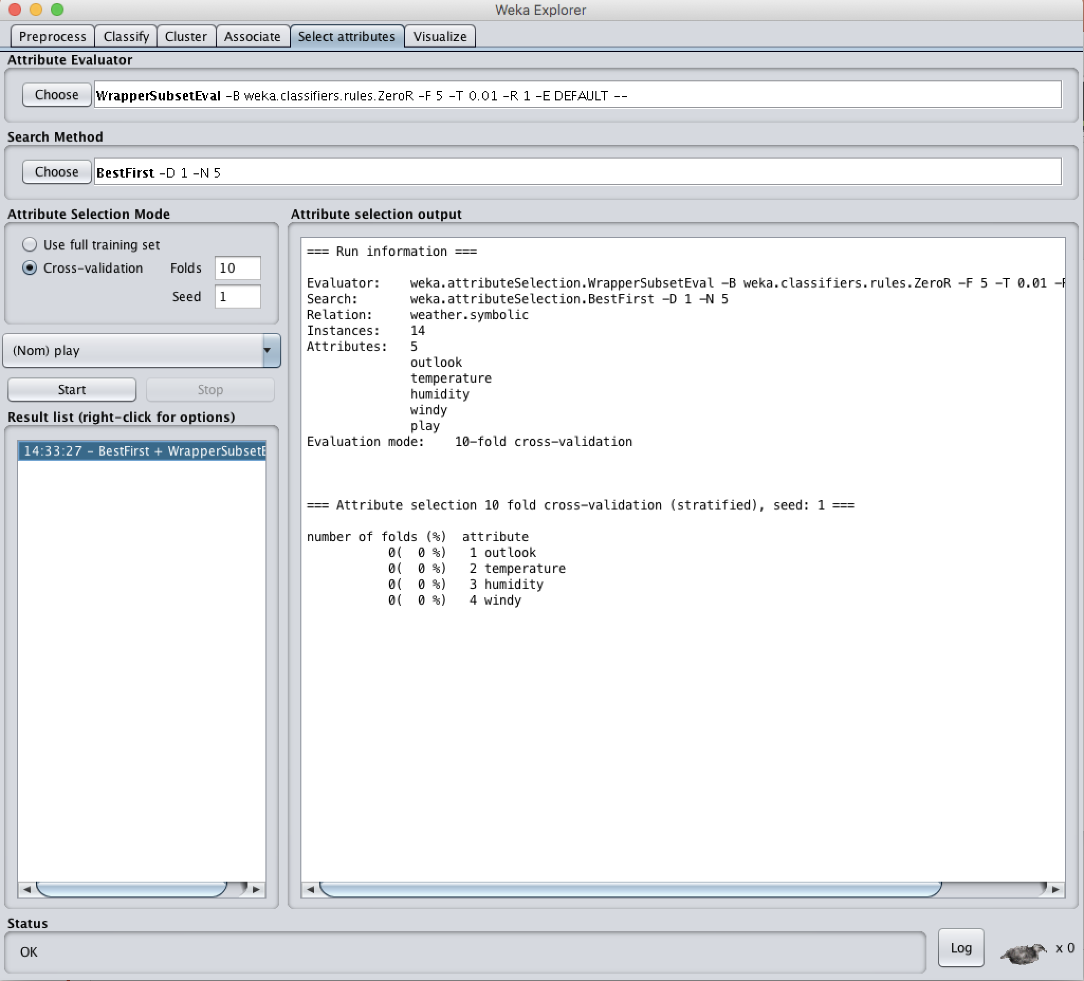
Select Attributes

Slide 17
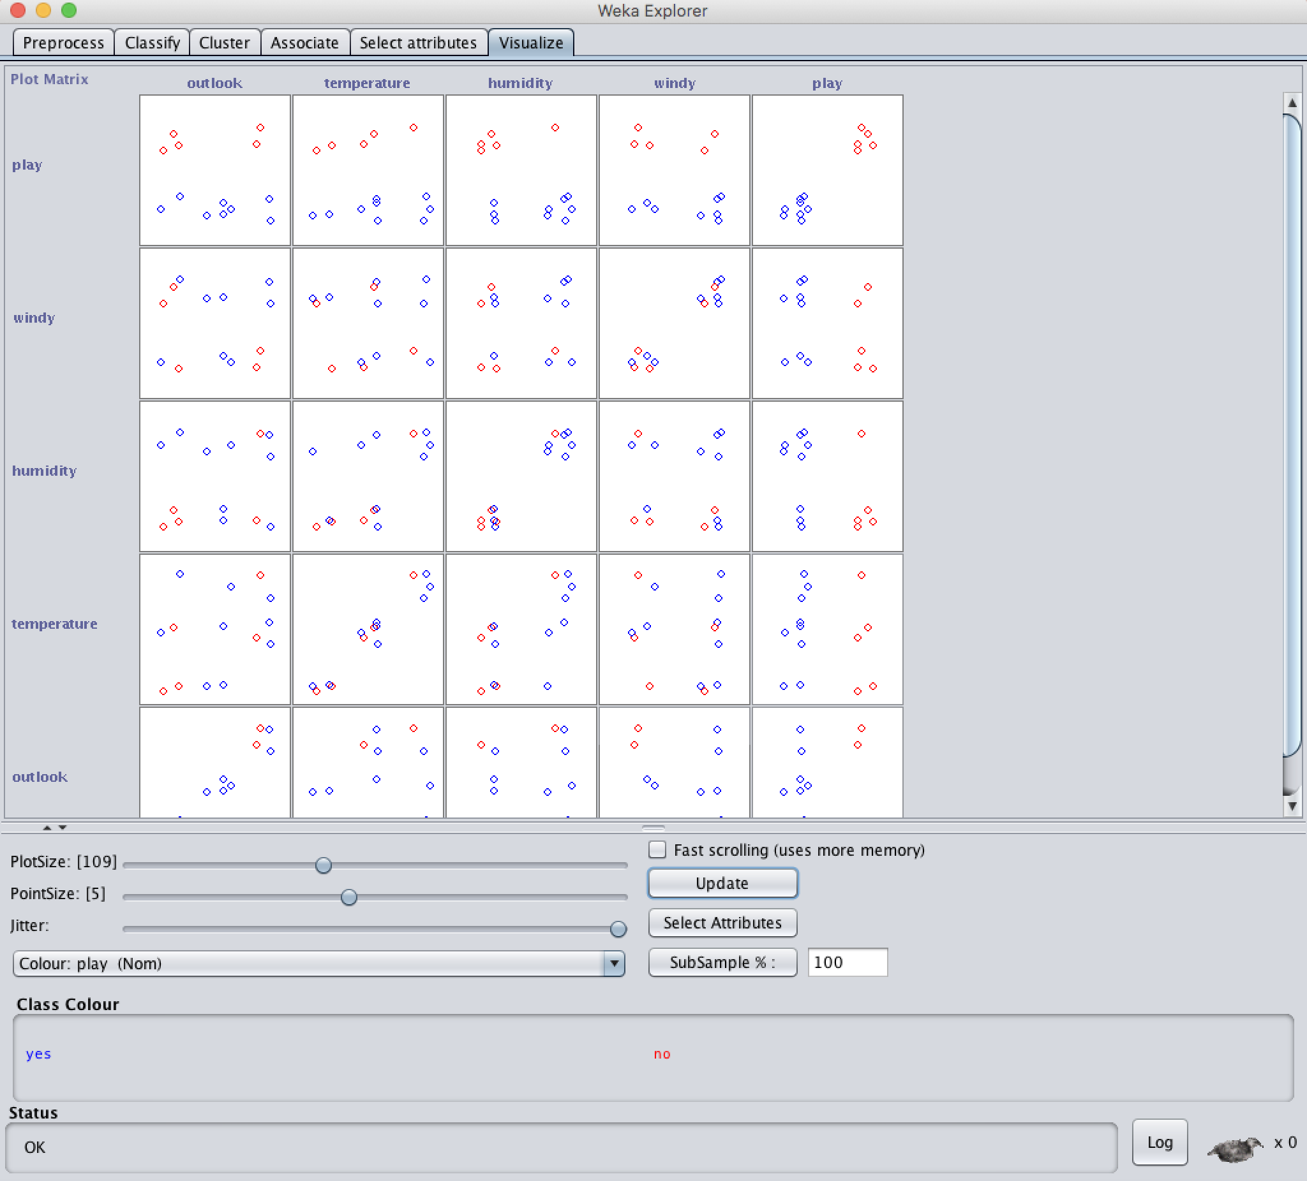
Visualization

Slide 18
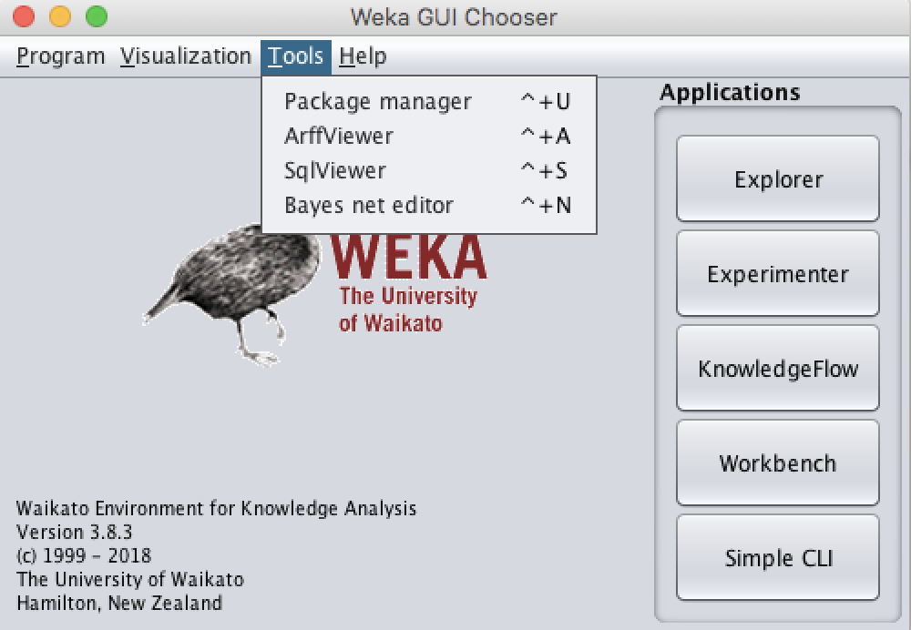
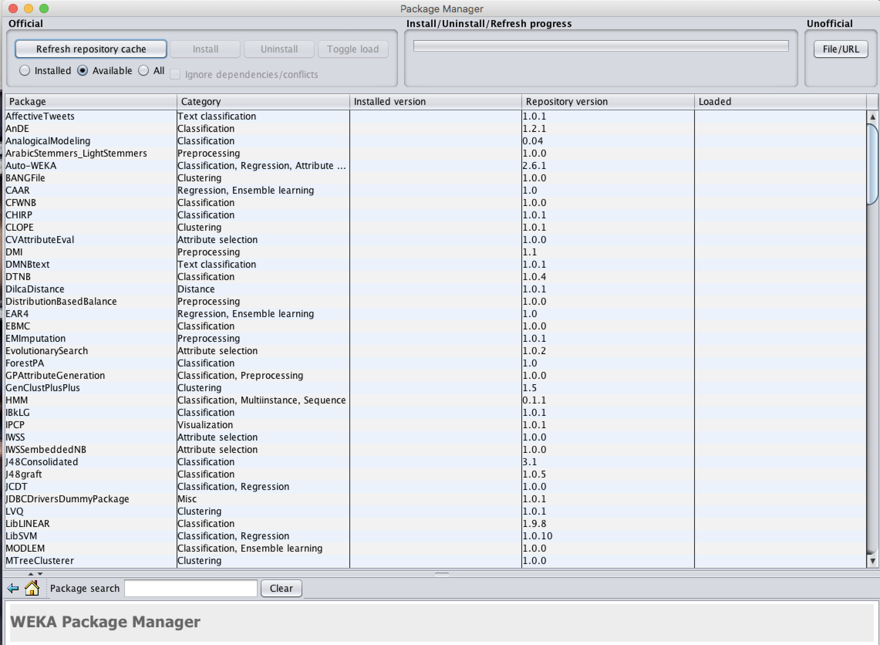
Package Manager

Slide 19
Summary
Weka
Pre processing
Classification
Associate / Selecting Attribute
Clustering
Visualization
Time for working with Weka

Slide 20
References:
WEKA website: http://www.cs.waikato.ac.nz/~ml/weka/index.html
WEKA Tutorial:
Machine Learning with WEKA: A presentation demonstrating all graphical user interfaces (GUI) in Weka.
A presentation which explains how to use Weka for exploratory data mining.
WEKA Data Mining Book:
Ian H. Witten and Eibe Frank, Data Mining: Practical Machine Learning Tools and Techniques (Second Edition)
WEKA Wiki: http://weka.sourceforge.net/wiki/index.php/Main_Page
Others:
Jiawei Han and Micheline Kamber, Data Mining: Concepts and Techniques, 2nd ed.

Slide 21

Question?
THANK YOU!

